Slide 1

Notes:
1st slide (Mandatory)

Slide 2

Booth’s Algorithm
Notes:
Cover Page
Font: Nunito Sans
Primary colors: Black, White and Red (#F05136)
General Instruction:
Copy paste the required slide into your PPT. Format it there.
Write less, talk/present more
Use the font Nunito Sans Regular. You can download it from google fonts (https://fonts.google.com/specimen/Nunito+Sans).
Don’t change the size and/or positions of headings, texts, unless absolutely necessary.
The size of the image must be adjusted according to the text (try to make it look visually attractive)
1 image per slide

Slide 3
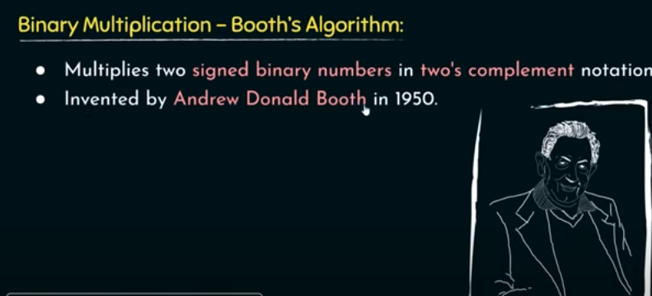

Notes:
Title + Text

Slide 4
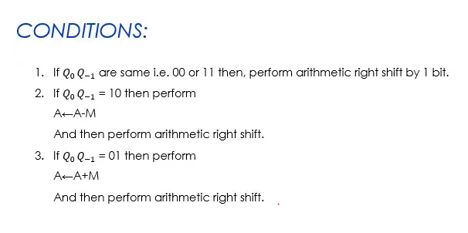
Notes:
Title + Text

Slide 5
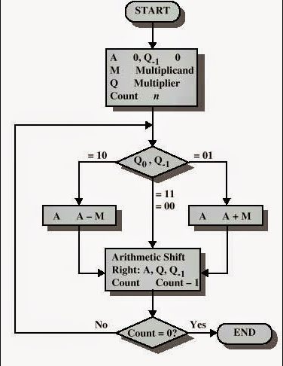
Notes:
Title + Text

Slide 6
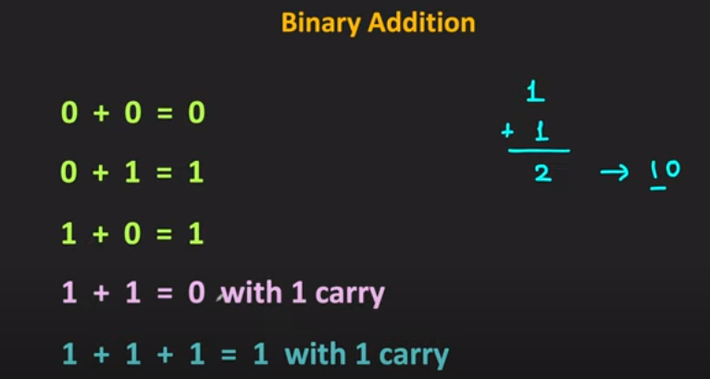
Need to ignore 0 and negative values
Notes:
Title + Text

Slide 7
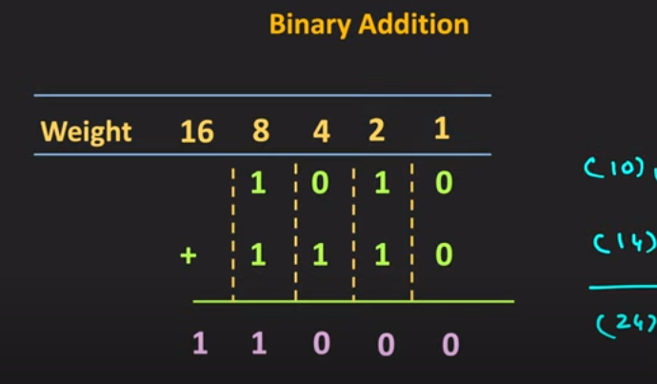
Notes:
Title + Text

Slide 8
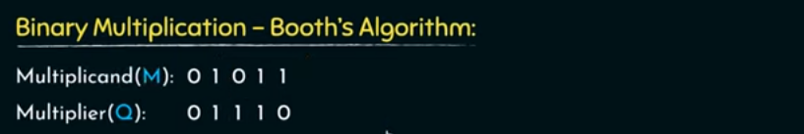
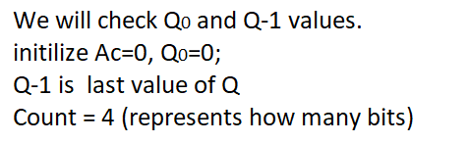
Notes:
Title + Text

Slide 9
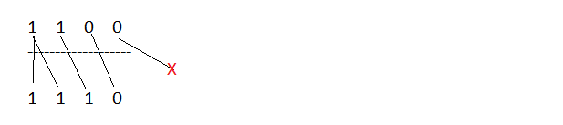

Arithmetic Shift Right
Notes:
Title + Text

Slide 10

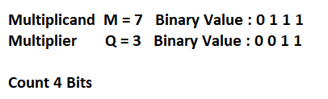
Notes:
Title + Text

Slide 11
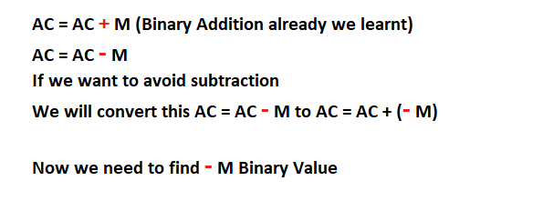
Notes:
Title + Text

Slide 12
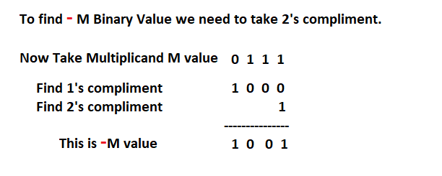
Notes:
Title + Text

Slide 13
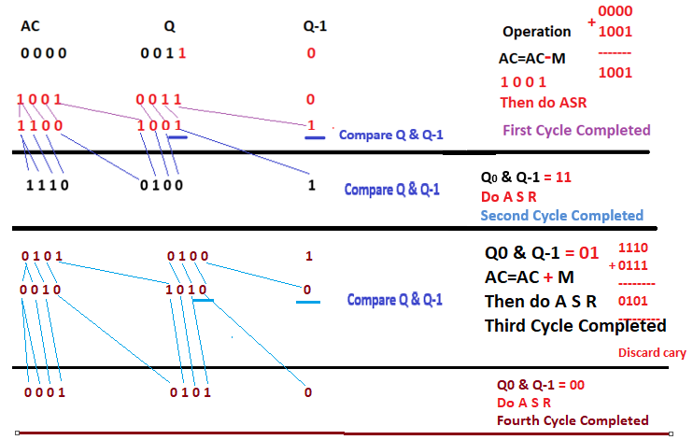
Notes:
Title + Text

Slide 14
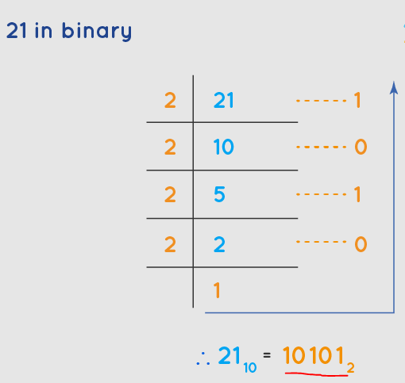
Notes:
Title + Text

